Slide 1
Network Security
Assignment 04
Ankit Kumar 2021015
Lakshay Chauhan 2021060

Slide 2
Project 3
On-the-go verification of Driver’s License

Slide 3
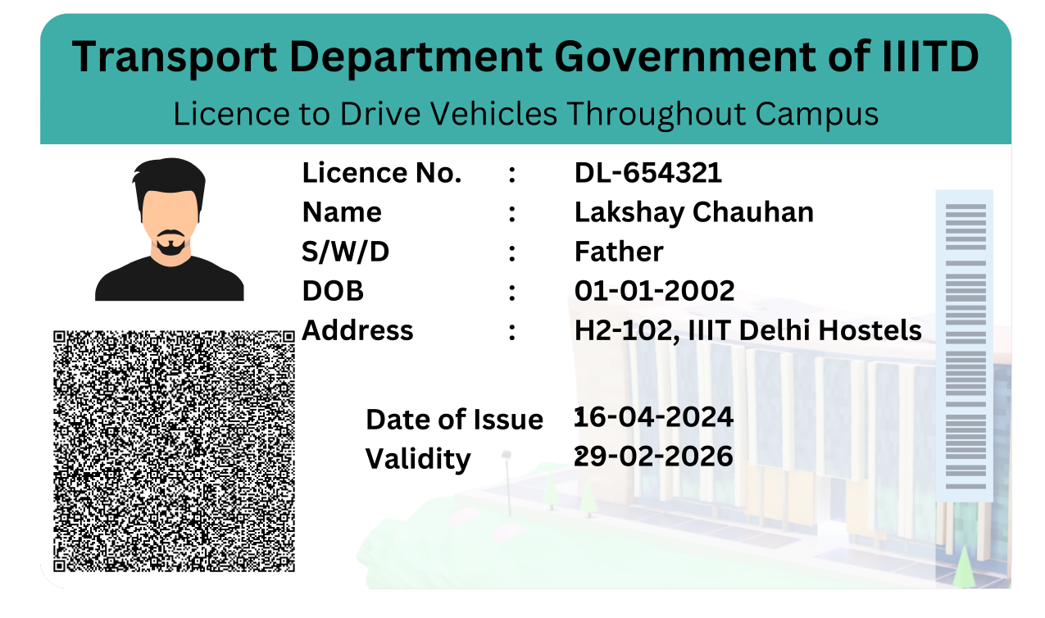
Sample Driving Licence

Slide 4
The above image is a sample driver's license. The driver's license contains the following information:
DL No: The driver's license number
DOI: The date of issue of the driver's license
Validity: The validity of the driver's license
Name: The name of the driver
DOB: The date of birth of the driver
Address: The address of the driver

Slide 5
How is the code working
data.json
{
"driving_license": {
"license_number": "DL-123456",
"full_name": "Ankit Kumar",
"date_of_birth": "01-01-2001",
"address": "H2-102, IIIT Delhi Hostel",
"issue_date": "15-04-2024",
"expiry_date": "29-02-2025",
"categories": ["A", "B"],
"restrictions": ["Glasses"]
}
}
this is how a new driving licence is generated. This is also used create data_signature from data that prevents data temparing

Slide 6
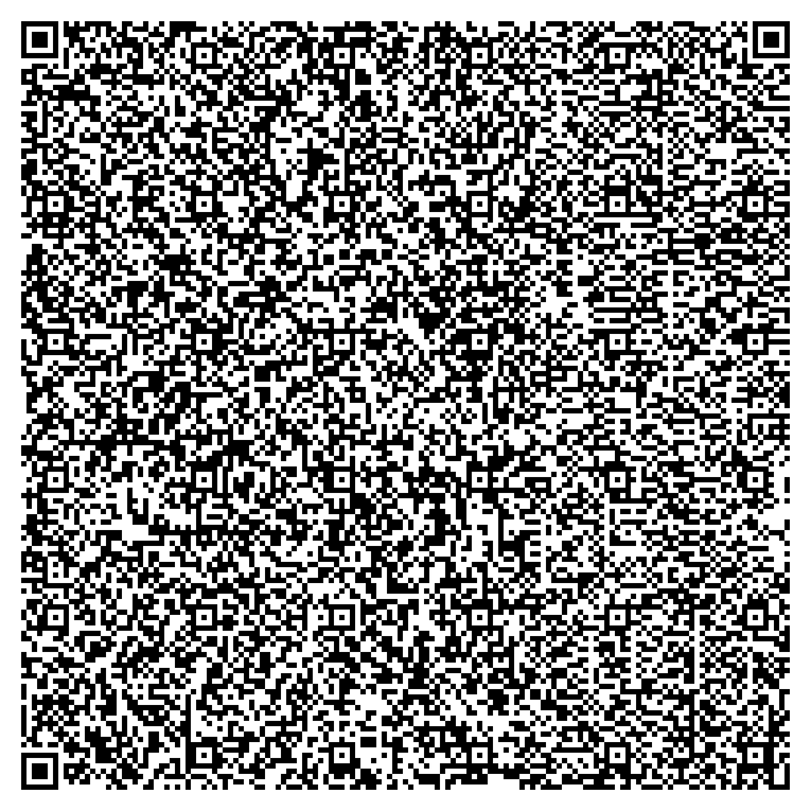
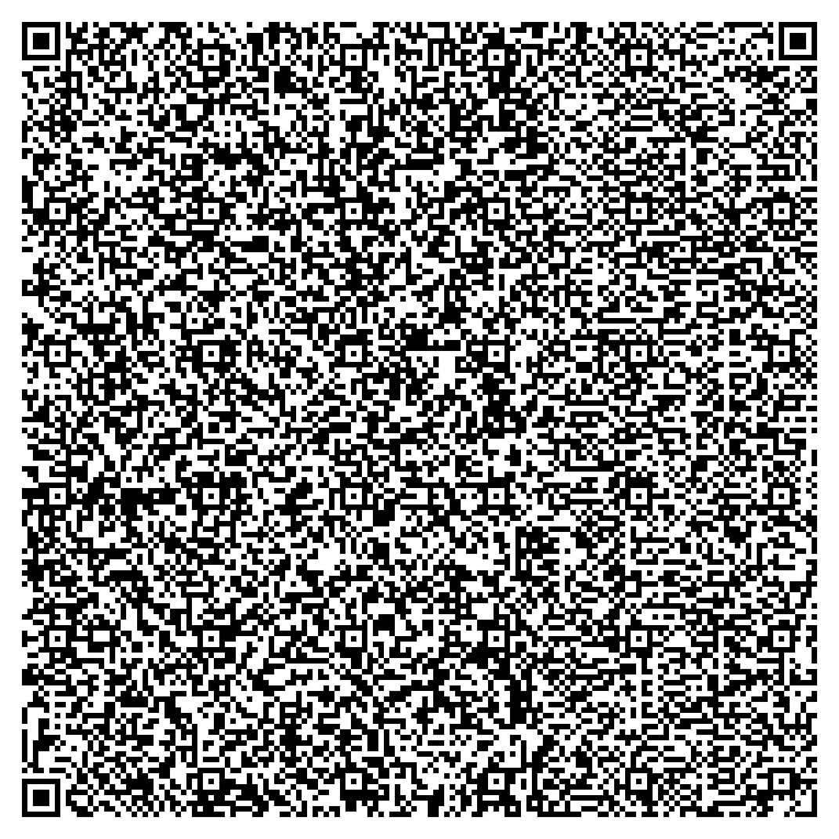
Generate QR will create QRs using the data.json that can be inserted into the driving licence card

Slide 7
if data.json is tempared or new qr code is generated by editing any of the fields, but the attacker cannot recreate the data_signature which was actually created with the data.json and salt using SHA256 algorithm.
Not only that, the data_signature is also being signed by the public key of the server.

Slide 8
Thank you

